Slide 1
iClean Solar-powered Compactors
By iClean Waste Management

Slide 2
iClean Solar powered Compactors
also known as a solar trash compactor or solar-powered waste compactor, is a device used to compress and reduce the volume of waste material. It utilizes solar power to operate, making it an environmentally friendly and energy-efficient solution for waste management. Here's how a typical solar compactor works.

Slide 3
Our Aim:
Is to empower and encourage environment conservation and facilitation to be collaborative and efficient starting with the households, businesses, and public services areas like universities, and schools and to link them with recycling facilities within the country and international.

Slide 4



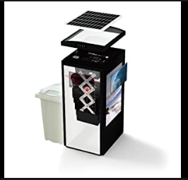
An example of solar powered mini kibubu waste compactor, we are on craft to create.

Slide 5
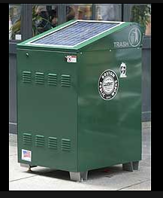
Average kolabo Composter

Slide 6
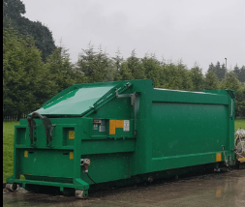
Kk Compactor

Slide 7
Solve the gap:
Environmental sustainability
Efficient space Utilization
Improved Hygiene and sanitation
Reduced waste collection Frequency
Cost Saving
Odor control

Slide 8

Compactors benefits contribute to cleaner, more efficient, and healthier living environments for residents.

Slide 9
Currently we rise money to start manufacturing the product……….

Slide 10
Thanks!

